Slide 1
Robot Simulation Using Gazebo and ROS
Presented by: Zhaopeng QIU
Course xxx

Slide 2

Course introduction
Objective: presents how to realize simulations in ROS using Gazebo
Teacher: name, xxx@inria.fr
Website:
Main topics:
  Gazebo simulator and its simulation framework
  Standard modelling description formats
  Gazebo integration in ROS
  Some examples
Prerequisite:
  ROS (groovy) knowledge
  Basic C++ programming skills
Course xxx

Slide 3

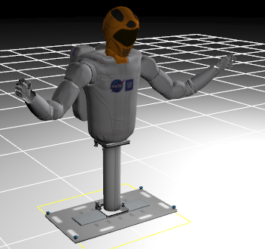
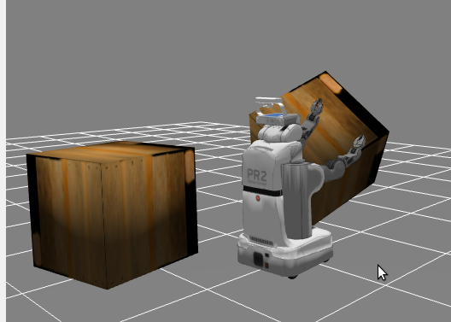
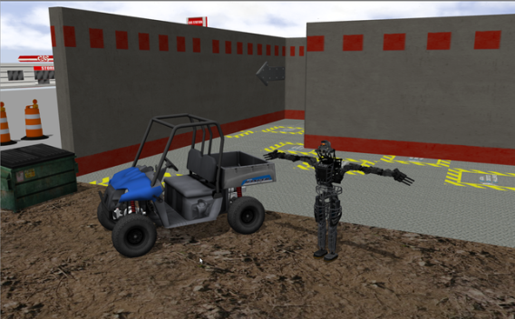

1. Gazebo simulator
Simulations in robotics
  Broadly used for testing and validating robot structures/software/algorithms
  Economic and efficient
  Dynamic simulations replacing kinematic simulations
Gazebo:
  A physique 3D simulator
  A ROS stack (no more in ROS Hydro)
  Now a stand-alone software
Course xxx

Slide 4
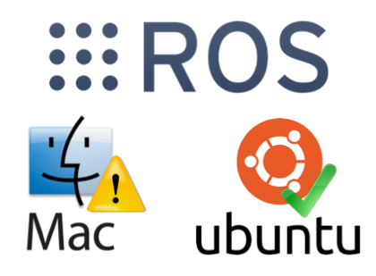
1. Gazebo simulator
Why Gazebo:
  A powerful physique simulator
    Physics engine: ODE (Open Dynamics Engine)
    Simulate both dynamics and kinematics
    Simulate interactions between robots and environments
  Various virtual sensors with realistic feedbacks
  Very good integration in ROS
  Highly extensible, open-source
Installation for ROS Groovy
  As a ROS stack (not recommended):
  sudo apt-get install ros-groovy-simulator-gazebo
  Stand-alone installation (highly recommended):
  see http://gazebosim.org/wiki/Tutorials/1.9/Installing_gazebo_ros_Packages
  or see file “Gazebo Simulator_ Introduction and Examples.pdf”.
Course xxx

Slide 5
1. Gazebo Simulator
Simulation framework using ROS and Gazebo
ROS
Launch simulation
User nodes (SLAM, AMCL, Navigation)
User input topics
Control commands
Sensor feedback
Simulated robot data
Gazebo
Robot 2
……
Robot 1
Links
Joints
Sensors
Controllers
Environment
Physics
Ground
Light
Gravity
Objects
spawn
Robot 3
……
Course xxx

Slide 6
2. Robot and environment modeling
Two modelling formats for Gazebo simulation:
  URDF: Unified Robot Description Format
  SDF: Simulation Description Format
URDF:
  An xml-based standard modeling format for defining robot prototypes in ROS
  Robot as well as its plugins defined in one or several files .urdf
  Xacro: macros applied in URDF
  Drawbacks:
    Lack of simulation information: light, gravity, friction, sampling time, …
    No environment definition: isolated robot description
More information:
http://wiki.ros.org/urdf
Course xxx

Slide 7
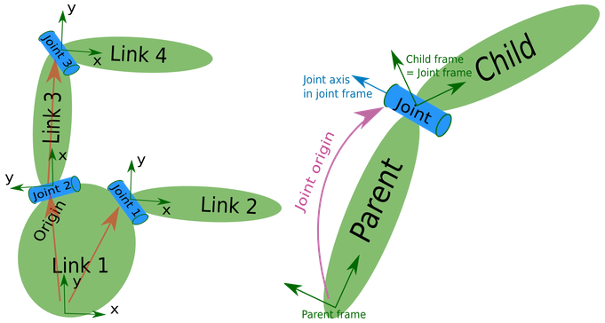
2. Robot and environment modeling
Robot structure in URDF:
<robot name="robot_model_name">
<link name="link1">
<visual> ...... </visual>
<collision> ...... </collision>
</link>
<link name="link2">
<visual> ...... </visual>
<collision> ...... </collision>
</link>
<joint name="joint_name" type="fixed">
<origin ... />
<parent link="link1"/>
<child link="link2" />
</joint>
</robot>
Course xxx

Slide 8
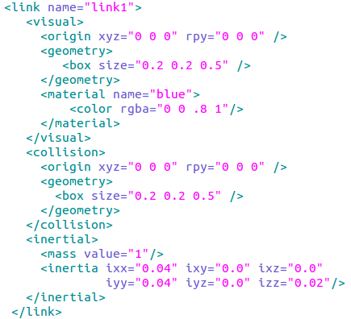
2.1 URDF introduction
Link definition
  Name
  Visual: visual properties
    Origin: position and orientation of link's visual part
    Geometry: 3D shape of the link, can use imported mesh files (.dae, .stl)
    Material: color or picture rendering apperance of the link
  Collision: shape for physic interation (collide, laser hit)
    Origin: position and orientation of link's physic part
    Geometry: 3D shape of the link, can use imported mesh files (.dae, .stl)
  Inertial properties
    Origin: frame in which the inertia is defined
    Mass: a scalar defining mass of the link (kg)
    Inertia: 3x3 matrix representing inertia of the link about its origin
Course xxx

Slide 9
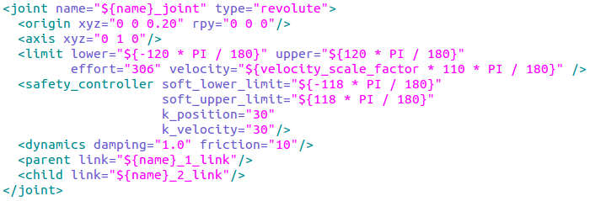

2.1 URDF introduction
Joint definition
  Joint name
  Joint type: revolute, continuous, prismatic, fixed, floating, planar
  Origin: defining related transform of child link regarding parent link
  Axis: rotation axis for revolute joint, tranlation direction for prismatic joint
  Parent and child links
  Other: calibration, dynamics, limit, mimic, safety_controller
Course xxx

Slide 10

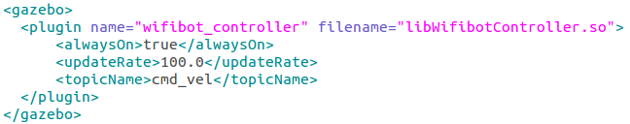
2.1 URDF introduction
Gazebo elements: URDF is not invented for Gazebo, so some extra elements should be defined for Gazebo simulations
  Gravity: enable or disable gravity of a link
  Material: colors and apperance displayed in Gazebo
  Plugins: sensors or controllers (default plugins of gazebo or plugins created by user)
Course xxx

Slide 11


2.1 URDF introduction
Gazebo plugins
  Give URDF models greater functionality
  Simulate sensor output and motor input
  Embed ROS messages and services
  Added for "robot", "link" or "joint" elements in URDF
  Availabel plugins: Camera, Multicamera, Depth Camera, Openni Kinect, Laser, Force, IMU, Joint Pose Trajectory, Projector, Prosilica Camera, Bumper, Differential Drive, Skid Steering Drive, Video Plugin, etc
  Plugin template: template for coding a user plugin as a library file (.so)
Course xxx

Slide 12
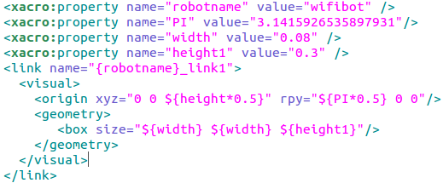

2.1 URDF introduction
Xacro (XML Macros) :
  An XML macro language
  Result in shorter and more readable XML files
  Easy tranlation to larger XML expressions
  ROS package xacro:
  rosrun xacro xacro.py robot.xacro > robot.urdf
Xacro usages:
  Constant value and math expression
  Using Rospack commands
  Including other xacro files
  Macros
More information:
http://wiki.ros.org/xacro
Course xxx

Slide 13
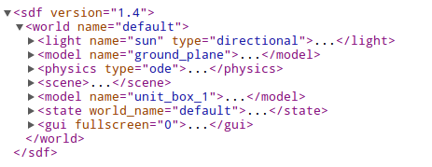
2.2 SDF introduction
SDF (Simulation Description Format) :
  An XML-based format used in Gazebo
  Define both world and model
  Similar to URDF, but overcomes drawbacks of URDF
  URDF can be transformed into SDF by gzsdf
SDF world structure
More information:
http://gazebosim.org/sdf.html
Course xxx

Slide 14
3. Launch Simulation in ROS
gazebo_ros_pkgs package:
  Containing a set of ROS packages for interfacing with Gazebo
  Only for stand-alone version of Gazebo
Launch Gazebo Server
  gzserver is an executable that runs the physics engine and sensor generation
Launch Gazebo Client
  gzclient is a graphical interface running in a separate process that attaches to and visualizes a world on a Gazebo Server
More information:
http://gazebosim.org/wiki/Tutorials/1.9/Installing_gazebo_ros_Packages
Course xxx

Slide 15
3. Launch Simulation in ROS
Spawn a URDF robot model into simulation
  Load URDF model into ROS server
  Call the executable spawn_model in ROS package gazebo_ros
Other ways to start Gazebo
# rosrun gazebo_ros gazebo
# rosrun gazebo_ros gzserver
# rosrun gazebo_ros gzclient
# rosrun gazebo_ros debug
Course xxx

Slide 16
4. Simulation Examples
4.1 Start Gazebo with an empty world
roslaunch tutorial_gazebo empty_world.launch
This example:
  Starts the Gazebo server with an empty world
  Empty world file ("empty.world") is located in path:
  $(GAZEBO_RESOURCE_PATH)/models
  Starts the Gazebo client which is a GUI window for visualizing the world as well as models in the simulation
  Modify a world: inserting and deleting models, inserting and deleting lights, changing element properties in the world, etc.
Course xxx

Slide 17
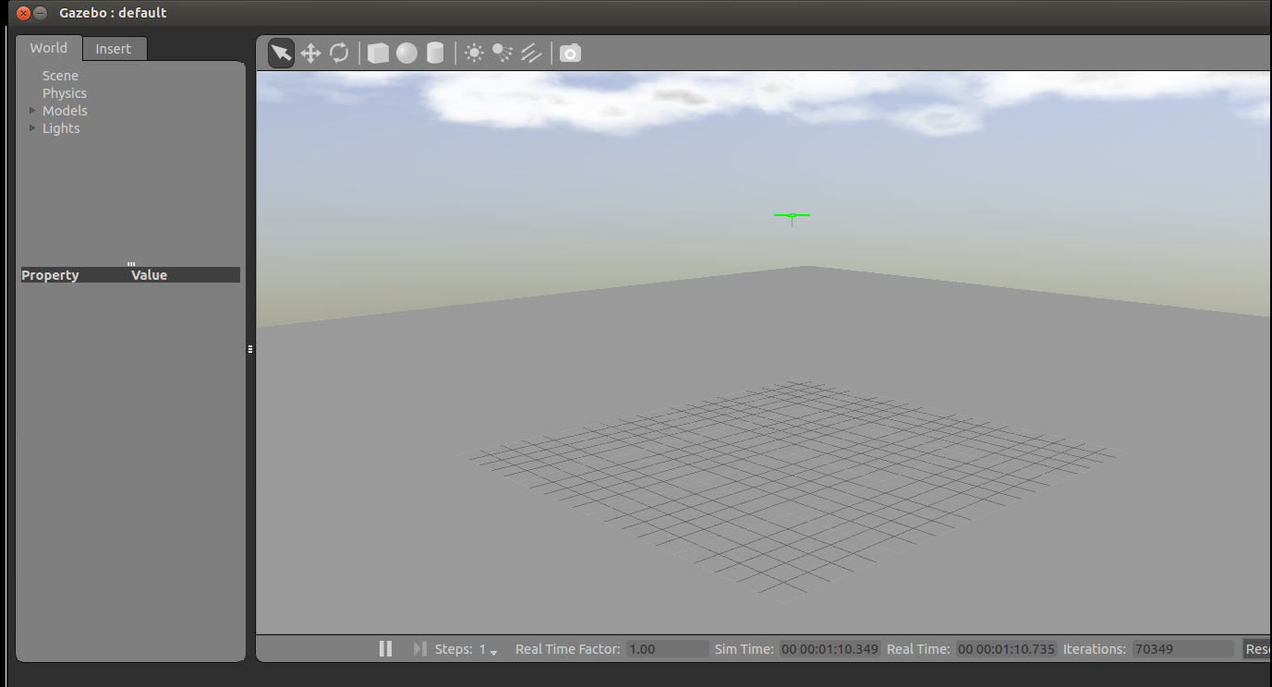
4. Simulation Examples
Gazebo client interface
Tool bar for manipulating objects, adding shapes or lights and taking screenshots.
visual world. Use mouse for zooming, translating, rotating the view.
insert existed models into the world
list of elements in the world
element properties
simulation information
Course xxx

Slide 18
4. Simulation Examples
4.2 Spawn wifibot into the world
  wifibot model is defined in file tutorial_gazebo/urdf/wifibot_demo.xacro
roslaunch tutorial_gazebo wifibot_demo.launch
This example:
  Starts the Gazebo server and Gazebo client with an empty world
  Load the wifibot model defined in file:
  gazebo_tutorial/urdf/wifibot_demo.xacro
  This model load:
    Material xacros for link colors in rviz (gazebo_tutorial/urdf/material.xacro)
    Lidar mesh file (gazebo_tutorial/meshes/hokuyo_utm_30lx.dae)
    Camera mesh file (gazebo_tutorial/meshes/camera.dae)
Course xxx

Slide 19
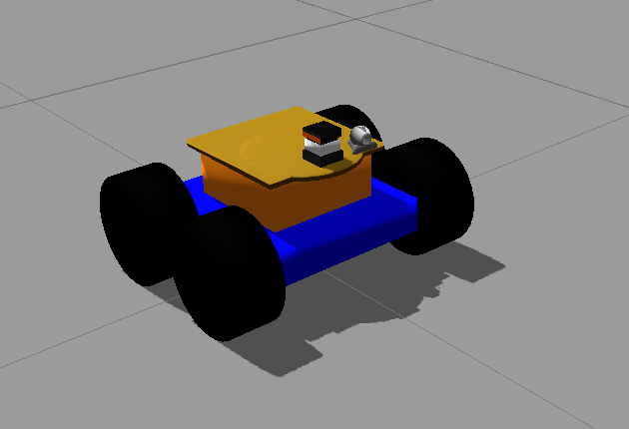
4. Simulation Examples
4.2 Spawn wifibot into the world
  Wifibot model in Gazebo as shown in figure below
  Sensor and controllers are not defined in robot model, so it cannot move or return sensor feedbacks
Course xxx

Slide 20
4. Simulation Examples
4.3 Spawn wifibot with sensors and controllers
  Robot model is defined in xacro file:
  tutorial_gazebo/urdf/wifibot.urdf.xacro
  Wifibot body macro is defined in file:
  tutorial_gazebo/urdf/wifibot_body.urdf.xacro
  Lidar sensor plugin, camera sensor plugin and motion controller are defined in:
  tutorial_gazebo/urdf/gazebo_wifibot.urdf.xacro
  A user-defined motion controller is compiled from package wifibot_controller, which subscribes topic "/cmd_vl" and makes wifibot move in the world
  A user-defined world is loaded:
    tutorial_gazebo/worlds/inria.world
    In this world, a series of walls and boxes are added in the empty world shown in previous simulations.
Course xxx

Slide 21
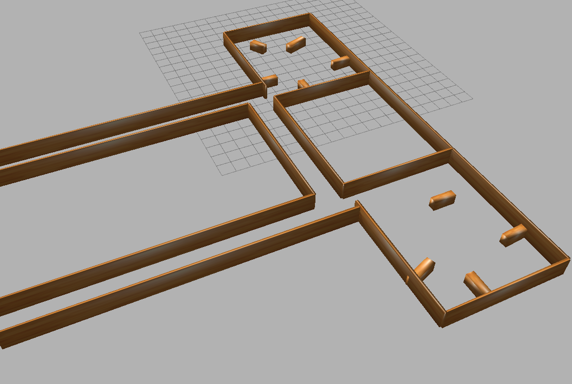
4. Simulation Examples
4.3 Spawn wifibot with sensors and controllers
  A ROS node coded in python for keyboard tele-operation:
  tutorial_gazebo/python/telop
  Control layout:
Moving around:
      u i o
      j k l
      m , .
    q/z: max speeds +/- 10%
    w/x: only linear speed
    e/c: only angular speed +/- 10%
    any other key: stop
Course xxx

Slide 22
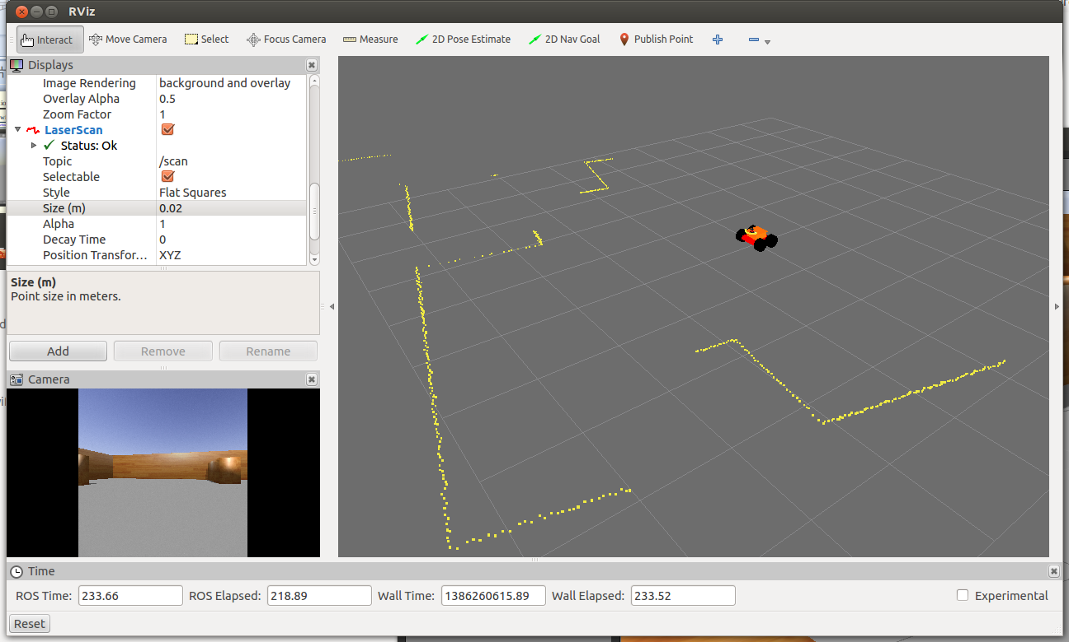
4. Simulation Examples
4.3 Spawn wifibot with sensors and controllers
In a terminal window, launch the simulation:
roslaunch tutorial_gazebo wifibot.launch
In a second terminal, run Rviz (add displays "robot model", "LaserScan", "Camera", choose fixed frame as "/base_link"):
rosrun rviz rviz
In another terminal, activate the tele-operation:
rosrun tutorial_gazebo wifibot_telop
Course xxx

Slide 23
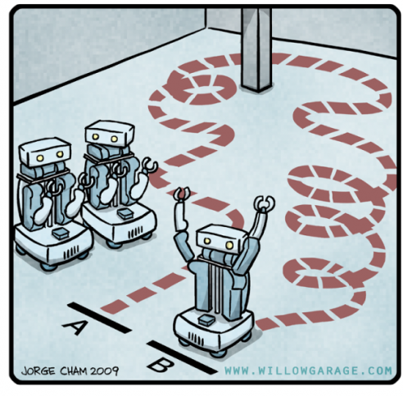
4. Simulation Examples
4.4 Autonomous navigation in a given map
  Robot:
  a wifibot which is equiped with camera, lidar and motion controller (same as in the previsou simulation)
  Simulation world:
  tutorial_gazebo/worlds/inria.world
  Simulation objective:
  autonomous navigation to given target
  poses (position and orientation)
Course xxx

Slide 24
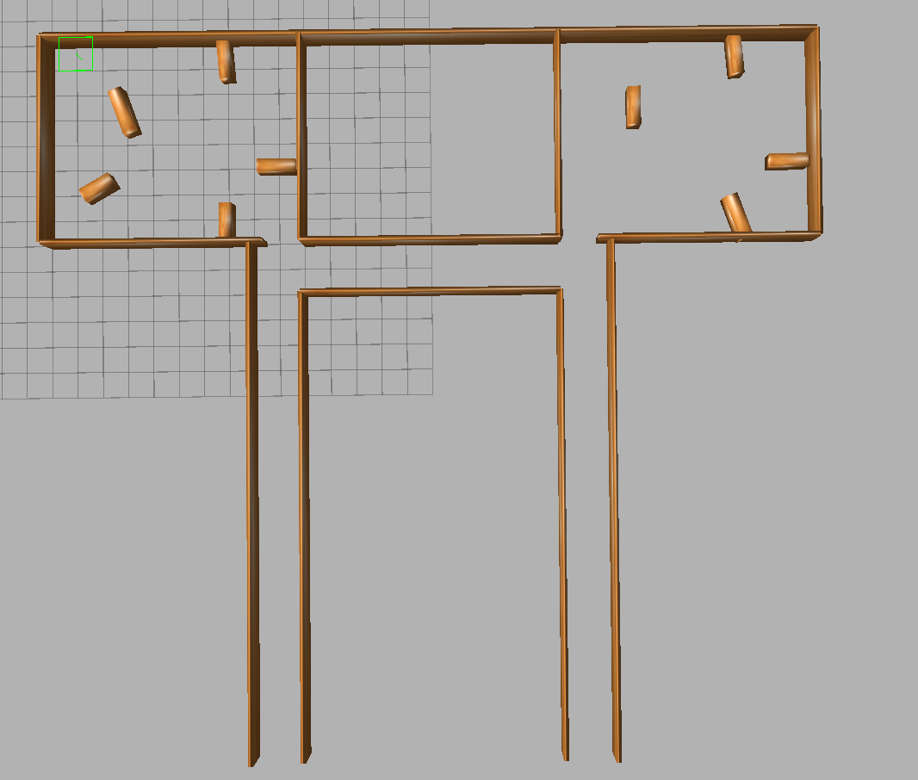
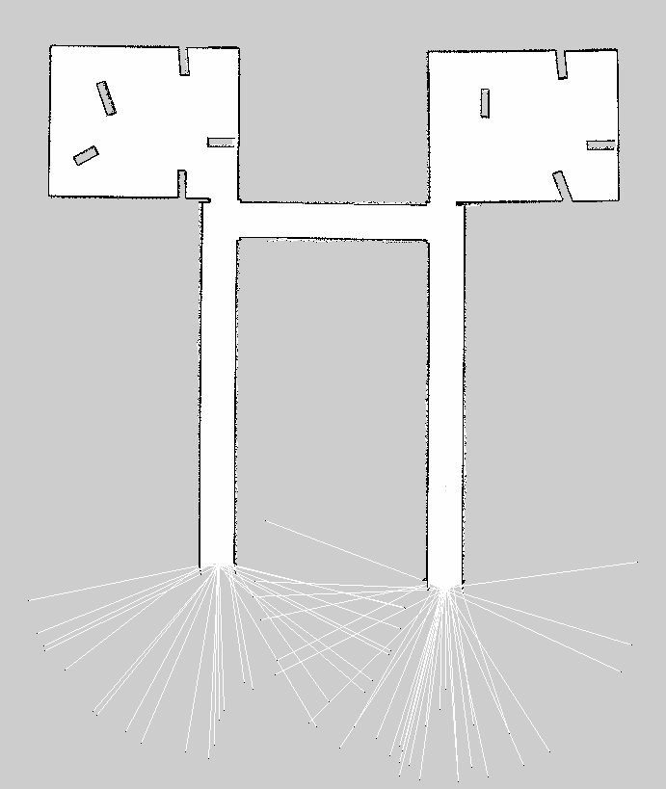
4. Simulation Examples
4.4 Autonomous navigation in a given map
  Map obtained by SLAM, saved as:
    a picture: tutorial_gazebo/maps/inria.pgm
    a parameter file: tutorial_gazebo/maps/inria.yaml
Course xxx

Slide 25
4. Simulation Examples
4.4 Autonomous navigation in a given map
Ths simulation is defined in one launch file tutorial_gazebo/launch/wifibot_nav.launch
which carries out the following tasks:
  Spawn wifibot model with sensors and controllers by including file:
    tutorial_gazebo/launch/wifibot.launch
  Load user map to ROS server via node map_server:
Course xxx

Slide 26
4. Simulation Examples
4.4 Autonomous navigation in a given map
  Run AMCL node for localization by including an amcl launch file:
    "tutorial_gazebo/config/wifibot/amcl_wifibot.launch"
  Run move_base node for motion planning and motion control by including move_base launch file:
    "tutorial_gazebo/config/wifibot/move_base_wifibot.launch"
Course xxx

Slide 27
4. Simulation Examples
4.4 Autonomous navigation in a given map
In a terminal window, launch the simulation:
roslaunch tutorial_gazebo wifibot_nav.launch
In a second terminal, run Rviz (add displays "robot model", "LaserScan", "Camera", "Polygon", "PoseArray", choose fixed frame as "/world"):
rosrun rviz rviz
Click 2D Pose Estimate and define initial pose
Click 2D Nav Goal for choosing goal position
Demo video
Course xxx

Slide 28
END
Thanks
Course xxx

